Slide 1
Texas Crime Analysis
Members:
Forrest Collier
Cade Culver
Jonathan Ezeugo
Troy Youngblood

Slide 2
Data Sources
Texas Counties : Land Area
https://txcip.org/tac/census/morecountyinfo.php?MORE=1005
Texas County Population
https://demographics.texas.gov/data/TPEPP/Projections/
Texas Department of Public Safety – Offense Codes
https://www.dps.texas.gov/administration/crime_records/pages/appndxKOffenseCodes.htm
Texas Department of Criminal Justice Offender List : October 28, 2020 Update
https://www.dps.texas.gov/administration/crime_records/pages/appndxKOffenseCodes.htm
As a note – there were 120,707 individuals listed in the offender list (in the prison system) for the October 28, 2020 update
Texas County Seat Coordinates
https://data.texas.gov/dataset/Texas-Counties-Centroid-Map/ups3-9e8m
Texas County Income by Race group
https://datausa.io/api/data?Geography=04000US48:children&measure=Household Income by Race,Household Income by Race Moe&drilldowns=Race

Slide 3
Project Description and Question Basis
Original Project Description
Analyze trends in Texas crime data by utilizing CSV files on crime, population, and land area
Amended Project Description
Analyze trends in Texas crime data by utilizing CSV files on crime and population
Land area was removed from the current evaluation criteria because overall county population was identified as a more descriptive value when identifying rates of offenses. Land area could be added in future evaluations.
Project Question Basis
The information collected and presented provides a high-level look at some of the general demographics of individuals and/or their crimes in the Texas Department of Criminal Justice (TDCJ) system. The challenge of the effort was to remain at a high level and not dive deeper into a specific case or a county for this first pass on the data. There are many stories which could be investigated during a later evaluation of the data. For the first pass on the data, the questions presented in the following slides were investigated.

Slide 4
Question 1 – Forrest Collier
Part 1: For the top five offenses in the top metro counties, how do the offenses per population differ based on race category?
Motivation: Do race groups have similar likelihoods of offense regardless of county, and is it appropriate to group them together?
Display results as a grouped bar chart of County and Race
Part 2: How does income affect the likelihood of offenses in each race group and which offense has the highest correlation with income?
Motivation: Does the common belief that income is highly correlated with crime hold weight?
Display results as a bar chart of offense per population overlayed with a line graph of income per race group per county

Slide 5
Top Counties, Offenses, and Race Groups
Top Metro Counties in Texas | Population
Harris County | 4,646,630
Dallas County | 2,606,868
Tarrant County | 2,049,770
Bexar County | 1,952,843
Travis County | 1,226,805
Collin County | 973,977
Hidalgo County | 855,176
El Paso County | 836,062
Denton County | 833,822
Fort Bend County | 765,394
Top Offense Categories in Texas | Total Offenses
Sexual Assault | 22,052
Assault | 17,812
Robbery | 17,630
Drugs | 17,151
Murder | 14,937
Race Groups in Texas | Population
White | 11,929,568
Hispanic | 11,524,842
Black | 3,442,881
Asian | 1,430,236
Other | 142,764

Slide 6
Data Cleanup
Prison data taken from 1984 – 2019
Crimes are only accounted for if the person is sent to prison
Question one analysis is focused on the likelihood of certain race groups in the top 10 counties to commit offenses (offense counts are adjusted for population out in the question one slides below)
Key Metric: Offense per 1000 (i.e. if you are born a certain race in a certain county, what is your likelihood to commit a certain crime)
Key Metric: Average income (i.e. average salary for paid workers of a certain race in a certain county)

Slide 7
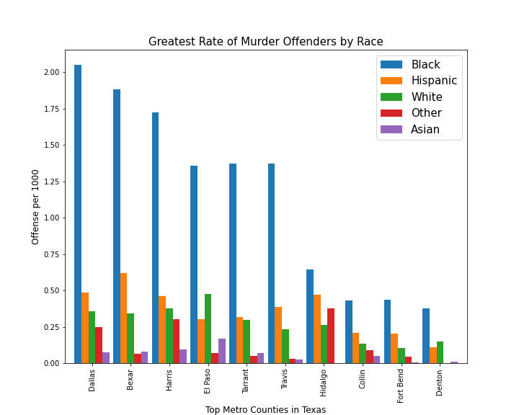
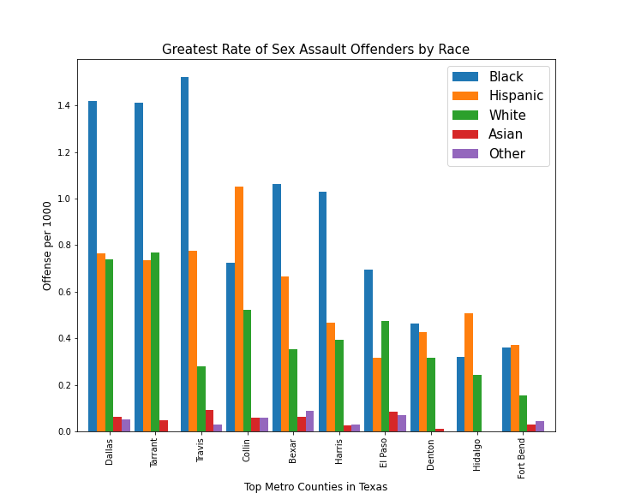
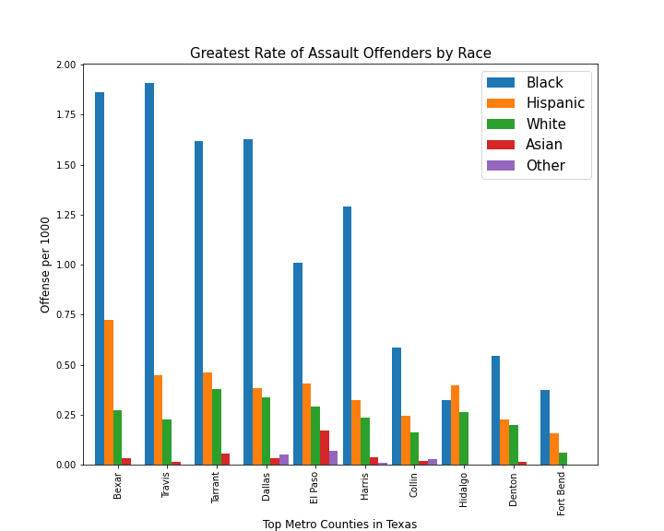
Part 1 – Crimes Against a Person
Key Insights
Variability – likelihood of offenses per race groups vary widely across counties Misleading to analyze crime for race groups in a whole state

Slide 8
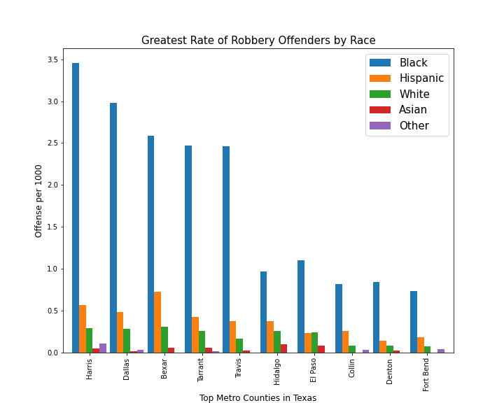
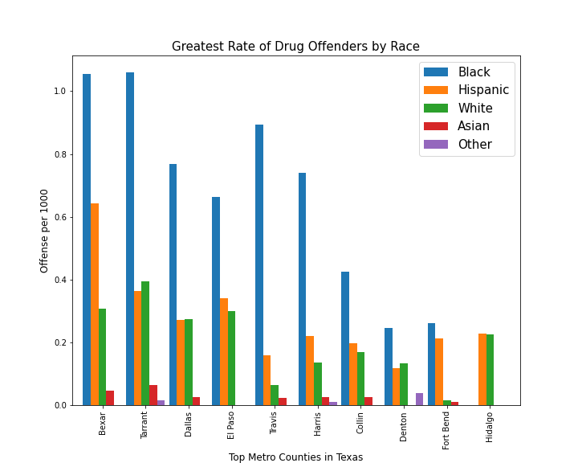
Part 1 – Crimes not Against a Person
Key Insights
Drug offenses more evenly distributed throughout race groups Two Mexican border counties (El Paso, Hidalgo) both have relatively low likelihoods of drug offenses per capita

Slide 9
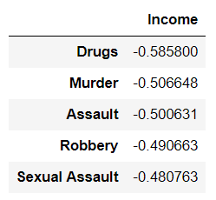
Part 2 – Correlation of Offenses and Income
Insights:
“Moderate” correlation for each offense
Sexual Assault prevalence among all race groups
Drug correlation ranks highest. Suggests police bias
Implications:
Drug arrests more prevalent among lower income groups potentially independent of drug usage

Slide 10
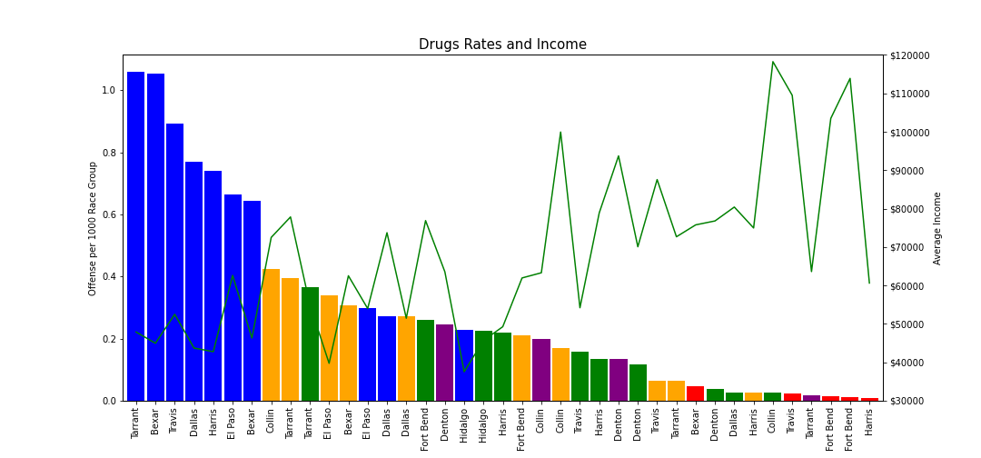
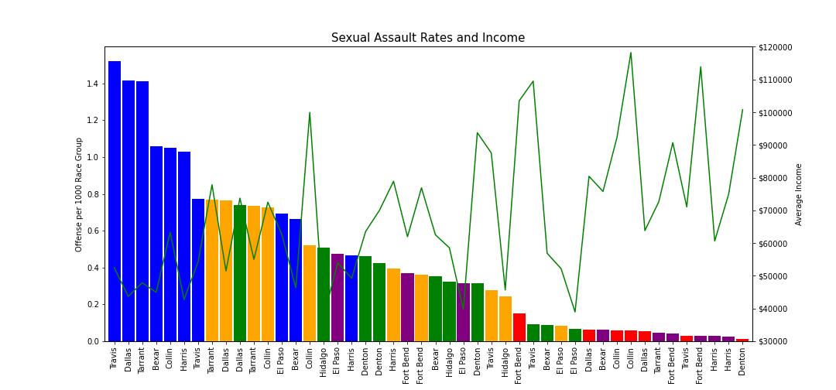
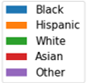
Part 2 – Correlation of Offenses and Income
Key Insights
Sharper decline in drug offense and sharper increase in income leads to the higher correlation (-0.58) Drug offenses are harder to detect and requires more targeted police investigation. Implication: Police could unfairly target African American communities for drug offenses | Sexual Assault more prevalent among all race groups independent of income Sexual Assault potentially more easily identified than other crimes leading to a lower correlation

Slide 11
Question 2 - Cade Culver
Part 1: What are the top 5 highest-sentencing offenses in Texas?
find the average sentence in years for all offense categories
display results in a data frame and the top 5 in a bar graph
Part 2: How does murder-sentencing around the major Texas cities compare to murder-sentencing in Texas as a whole?
look at murder sentencing in 5 Texas counties containing major cities (Harris, Dallas, Tarrant, Bexar, Travis)
obtain total count of murder offenses per county
compare each county’s average murder sentence with Texas state average

Slide 12
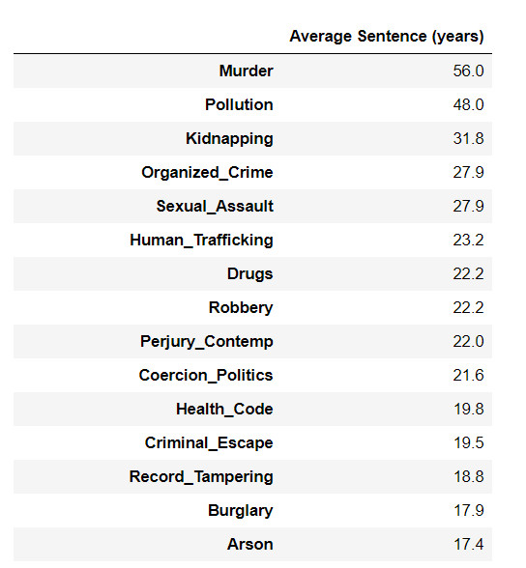
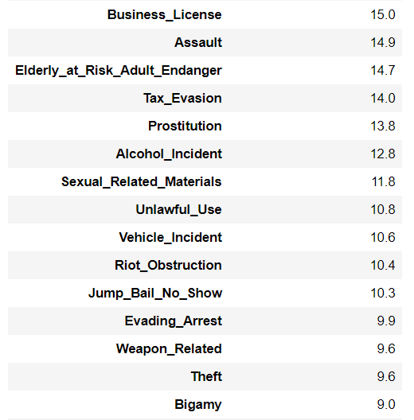
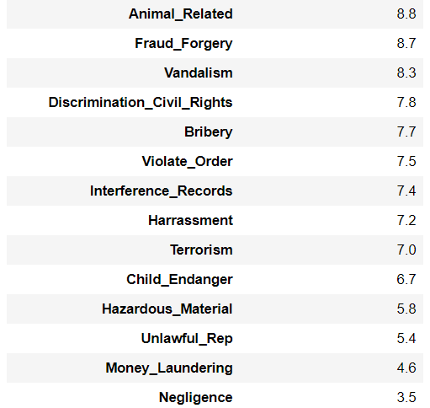
Part 1: Final Data Frame

Slide 13
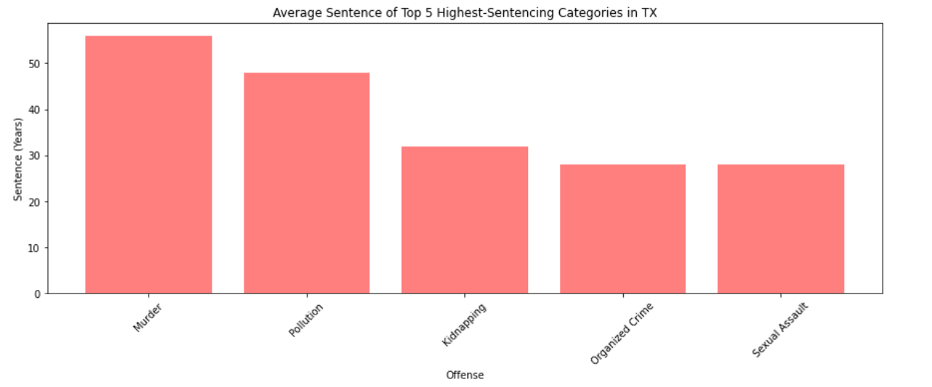
Part 1: Top 5 Highest-Sentencing Offenses in Texas

Slide 14
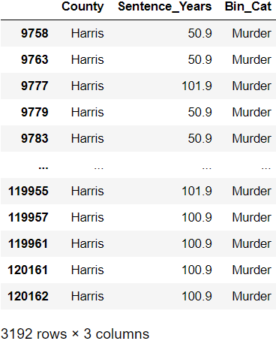
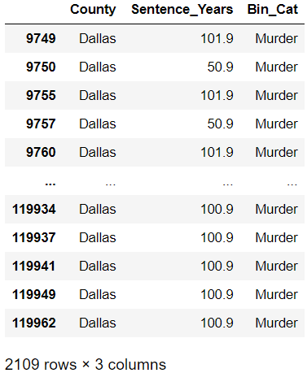
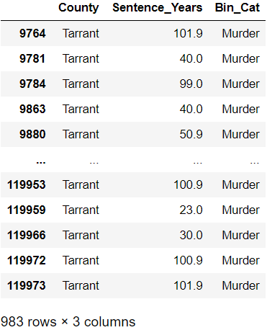
Part 2: Major County Data Frames

Slide 15
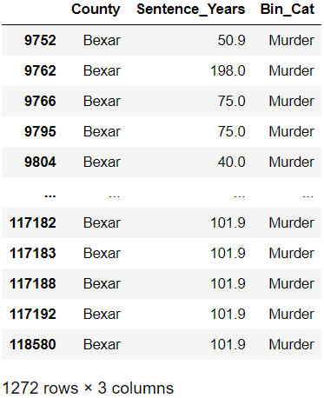
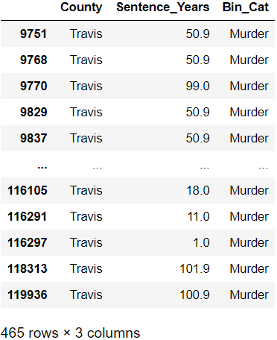
Part 2: Major County Data Frames, cont.

Slide 16
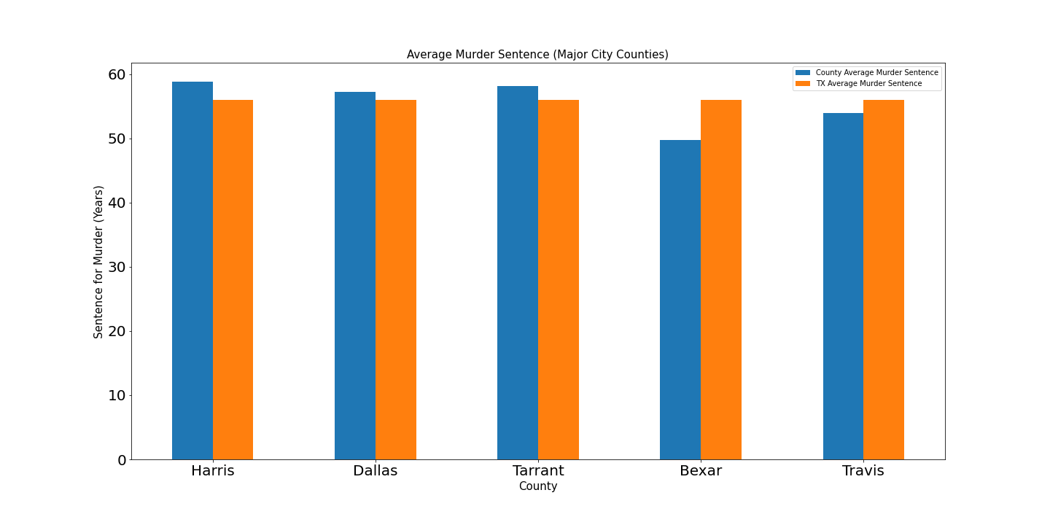
Part 2: Murder Sentencing Averages (Major Counties vs. Texas)

Slide 17
Q2 - Conclusions
The top 5 highest-sentencing offenses in Texas are: Murder, Pollution, Kidnapping, Organized Crime, and Sexual Assault. The odd offense in the data is Pollution. Two of these individuals had multiple violations and were given high sentences (about 48 years average) for “unauthorized disposal” of toxic waste and materials, in violation of an environmental act. This resulted in a big increase in the average sentence years. Other examples in this offense category are pollution of waterways, underground tank violations (causing leakage into groundwater), and disposal on government property such as state parks.
Murder was the highest-sentencing crime in Texas. Murder sentences in five counties containing the major cities: Harris (Houston), Dallas (Dallas), Tarrant (Fort Worth), Bexar (San Antonio), and Travis (Austin) counties were evaluated. The average murder sentence in Texas is 56 years, and Harris, Dallas and Tarrant county are all above that state average at 58.8, 57.2 and 58.1, respectively. Bexar and Travis are below the state average at 49.8 and 54. When comparing the number of murder offenses for each county with the average sentence, Bexar county has a high number of offenses (1,272) and a lower-than-average sentence rate. Tarrant county only has 983 murder offenses but has an above average sentence rate at 58.1 years.

Slide 18
Question 3 – Jonathan Ezeugo
Looking at the Texas crimes and population data the following questions were considered:
How do inmates in the Texas prison system segregate by age and gender in the top 10 counties and top 10 offenses?
Import, cleanup and produce data frame with all needed data
Dissect data frame into age brackets using age bins
Structure data frame for bar plot visualizations
How do the age and gender segregations compare with the county population data of respective age groups?
Import population data, cleanup and produce population data frame
Merge population data frame with offenses and counties data frame to produce new base data frame
Structure data frame for various bar plot visualizations

Slide 19
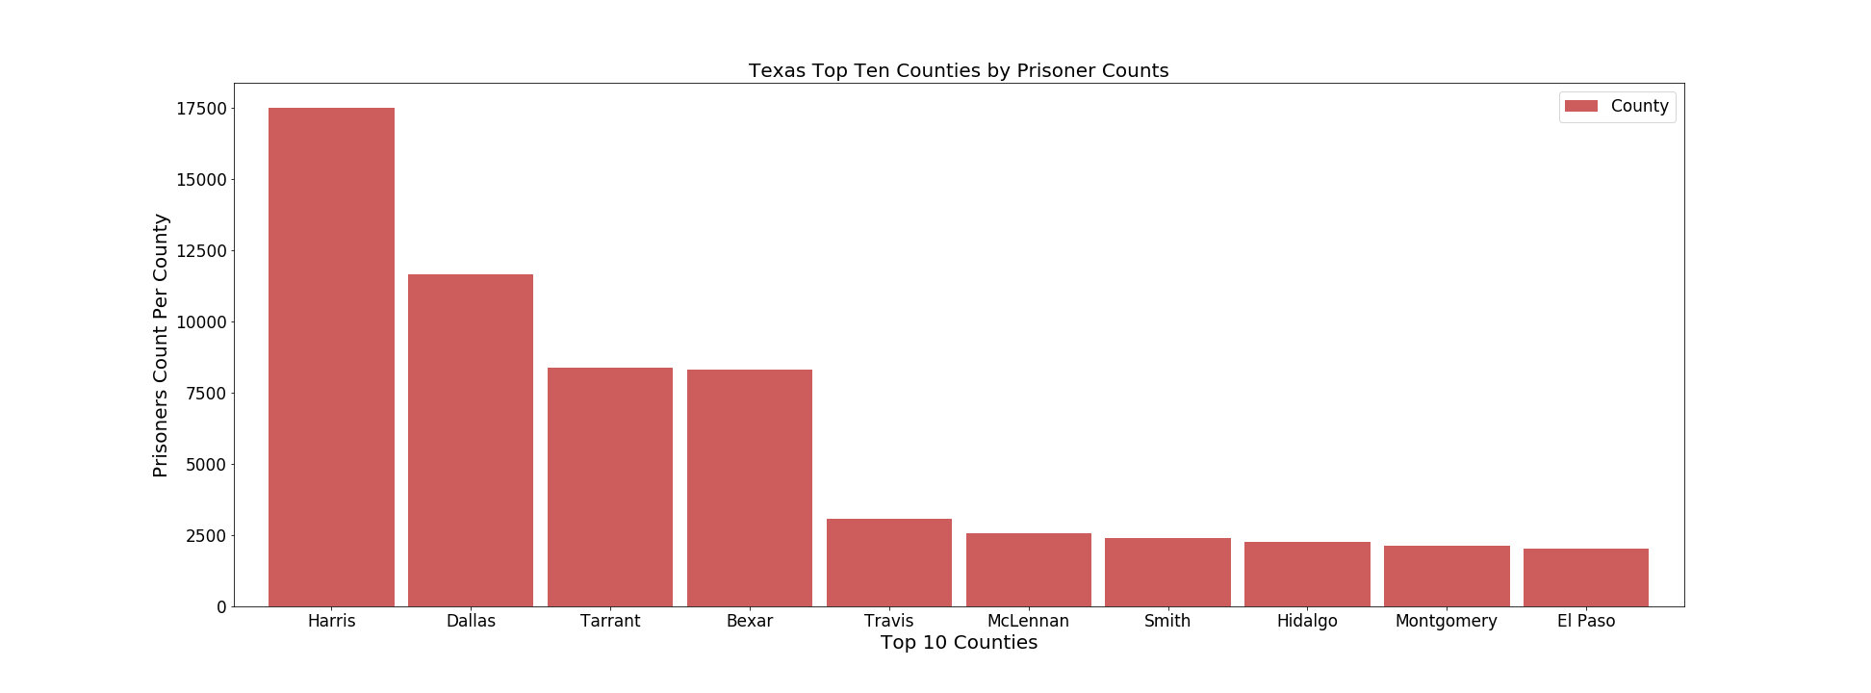
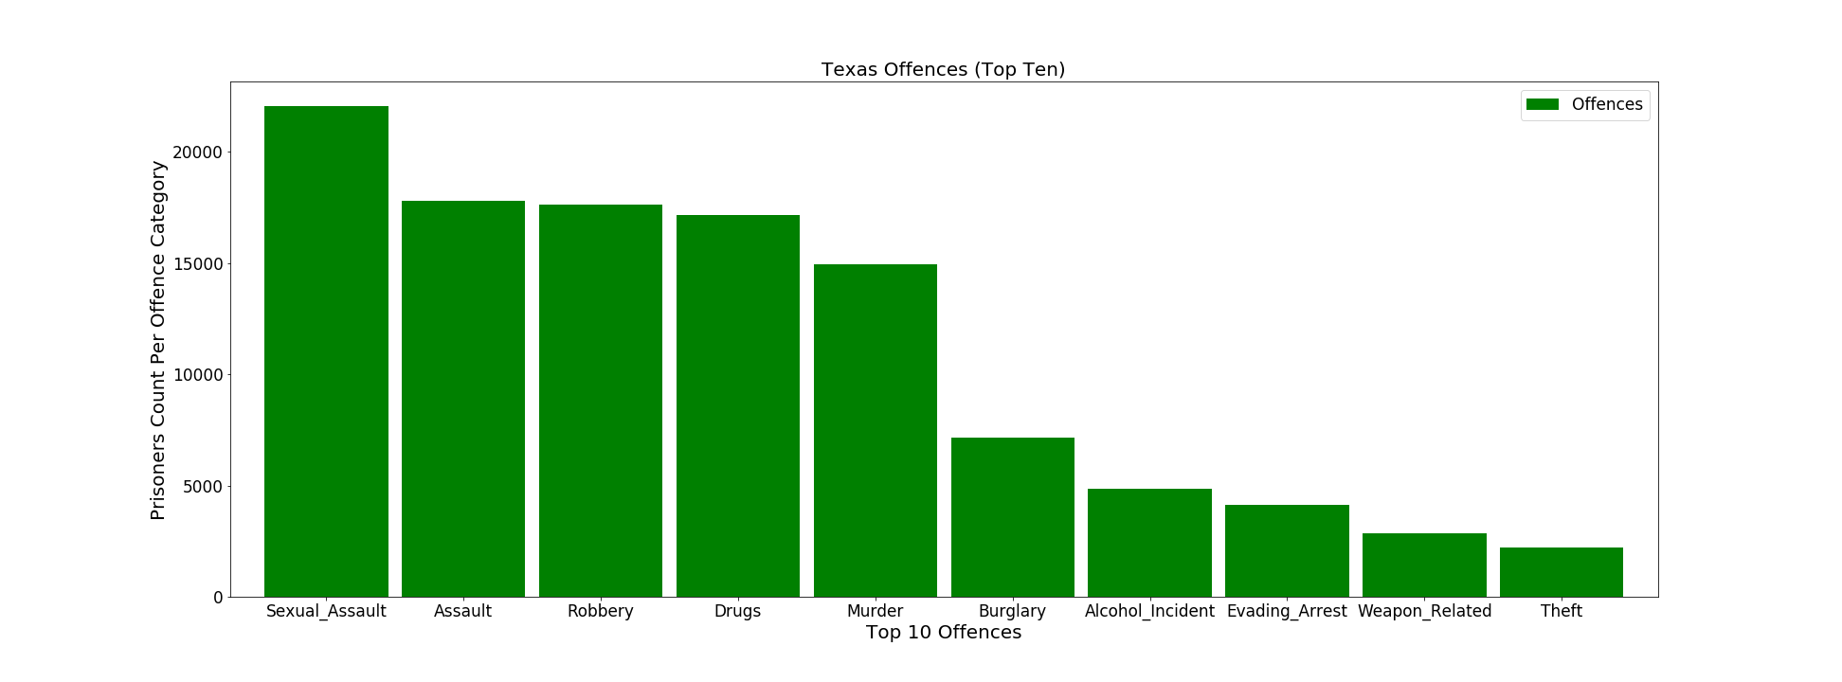
Foundational Data
Top 10 Counties
Top 10 Offences

Slide 20
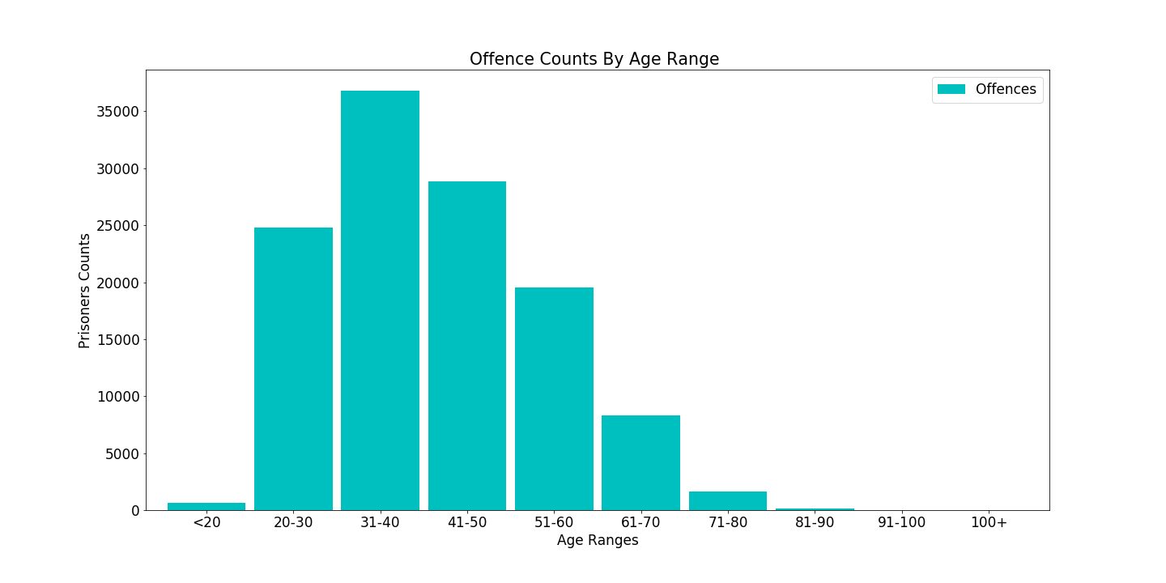
Texas Prisoners Spread By Age Groups

Slide 21
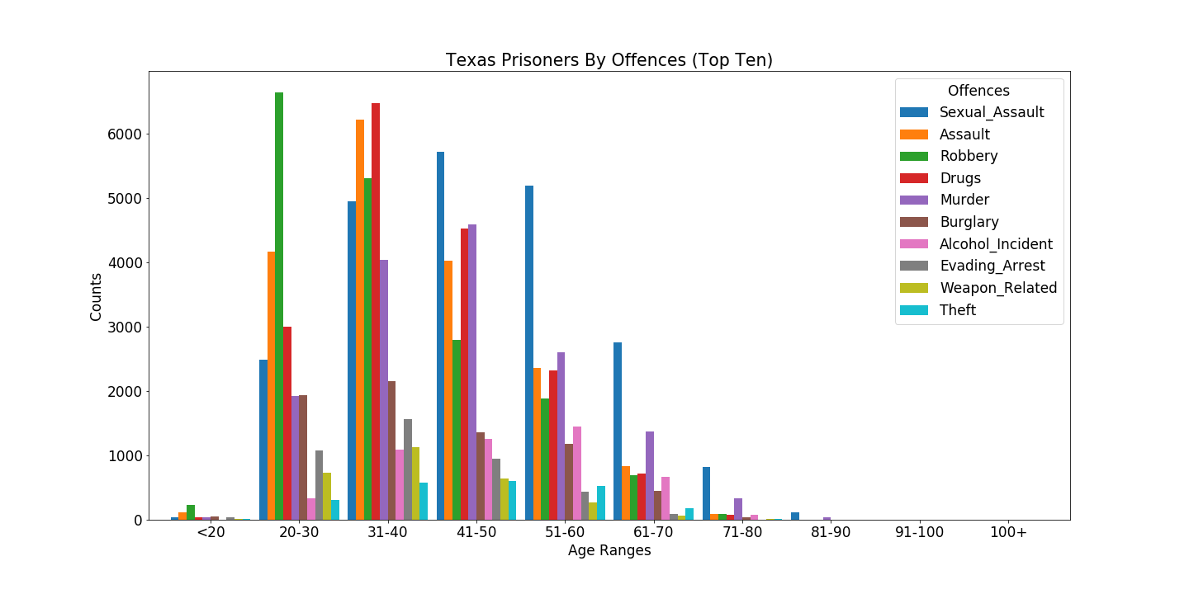
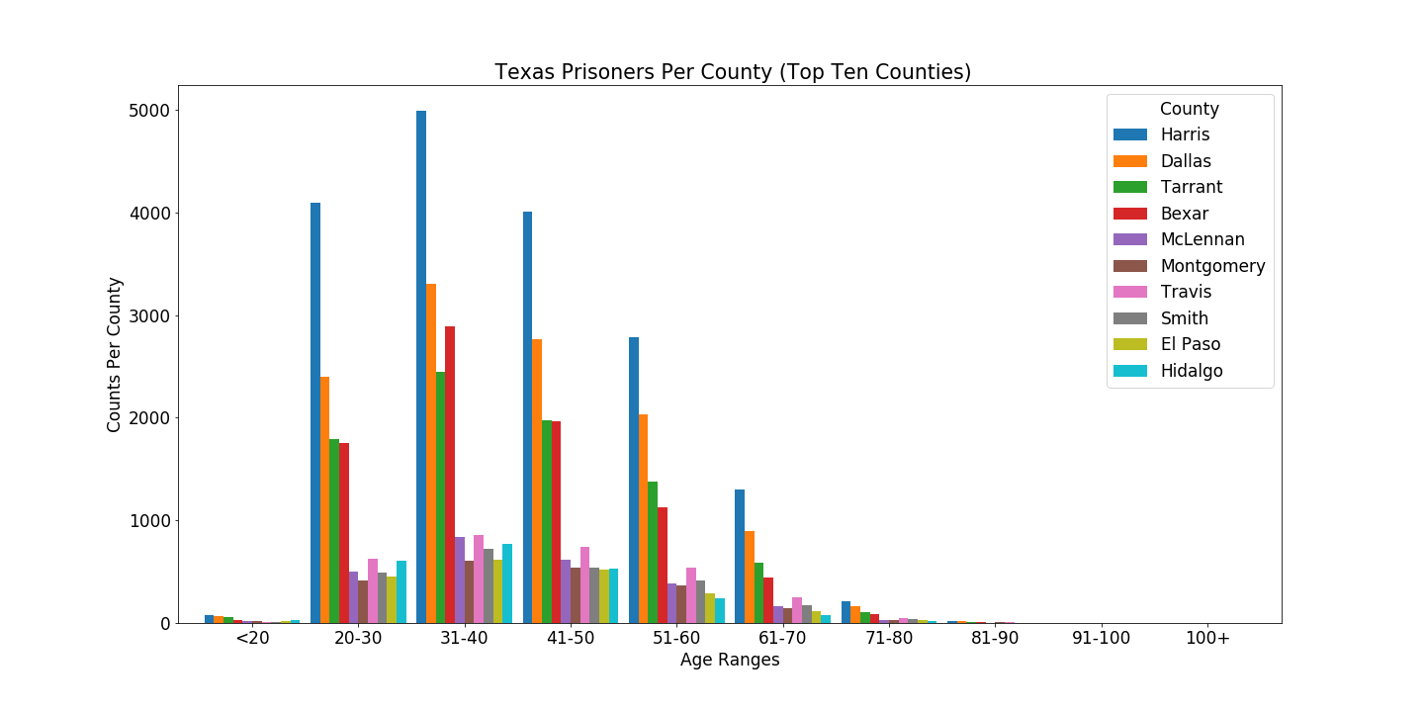
Texas Prisoners Age Spread
Age Spread By Offences
Age Spread By Counties

Slide 22
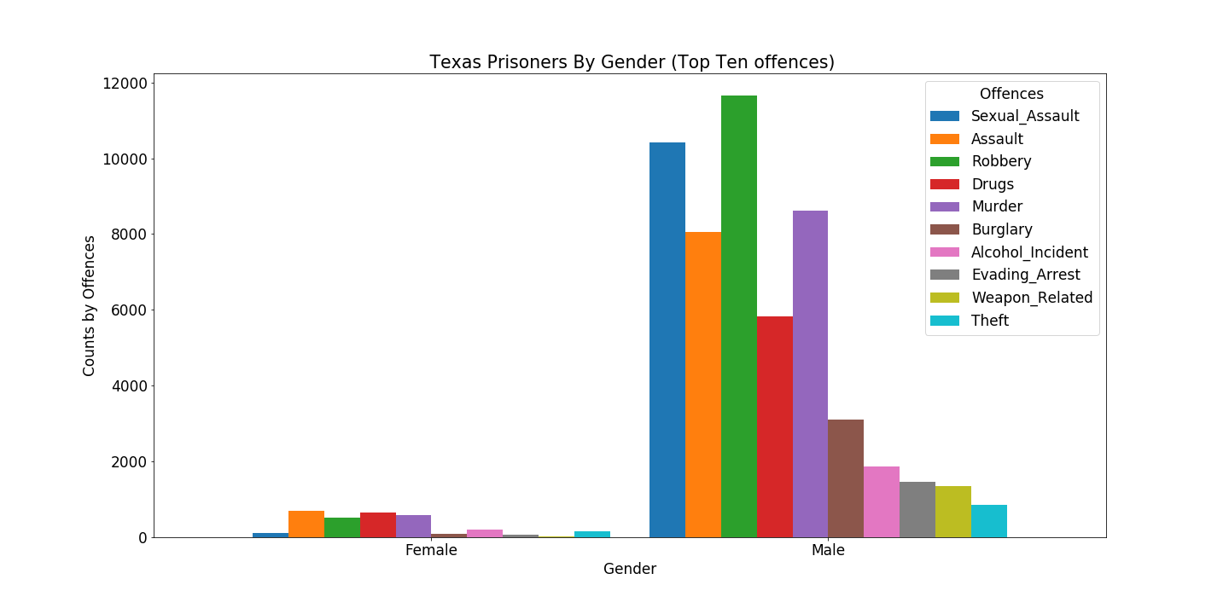
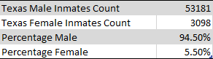
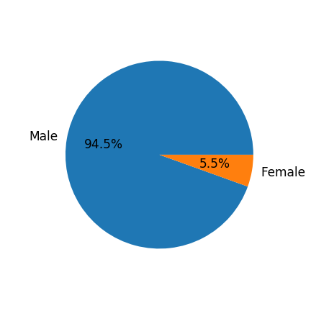
Gender Segregation Across Texas Prison System
Computation of Texas Prison Inmates Gender Percentage

Slide 23
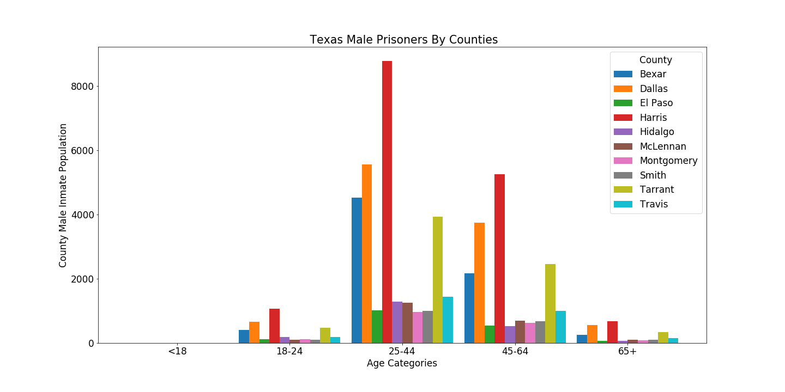
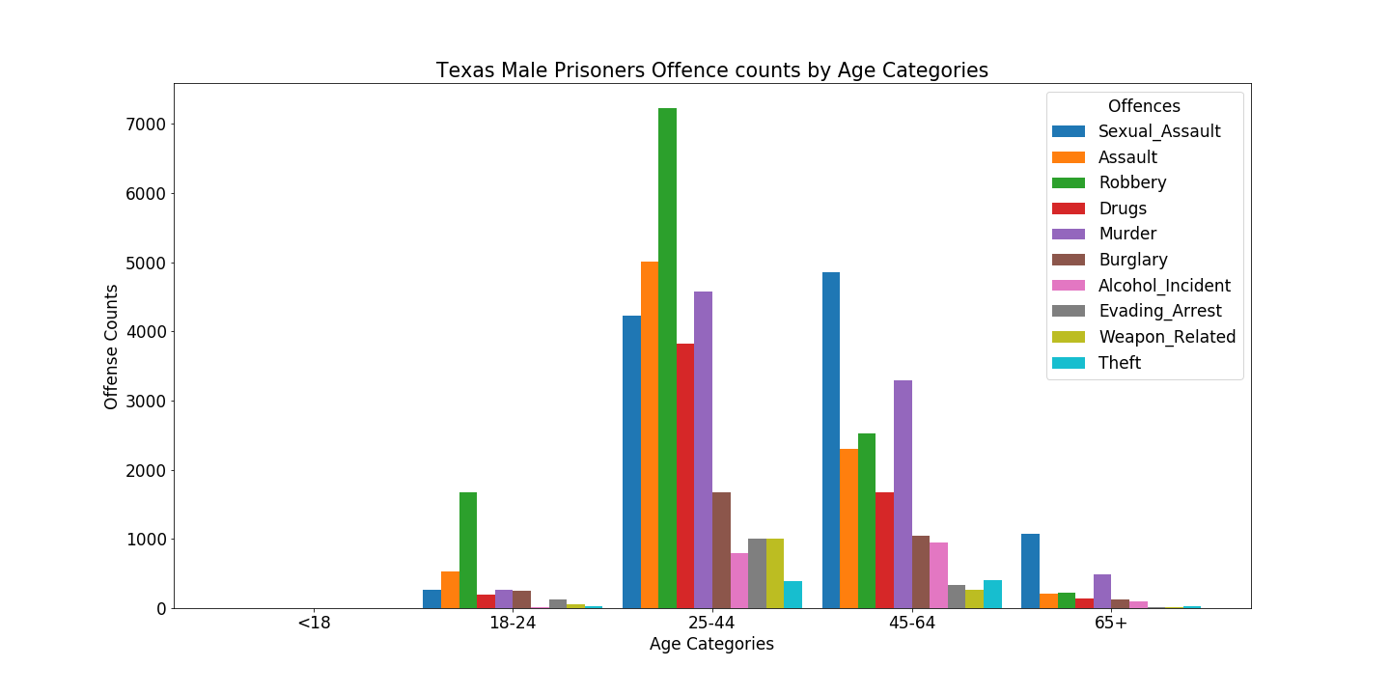
Texas Male Prison Inmate Age Segregation By Offense and Counties.
Male Inmates By Offenses
Male Inmates By Counties

Slide 24
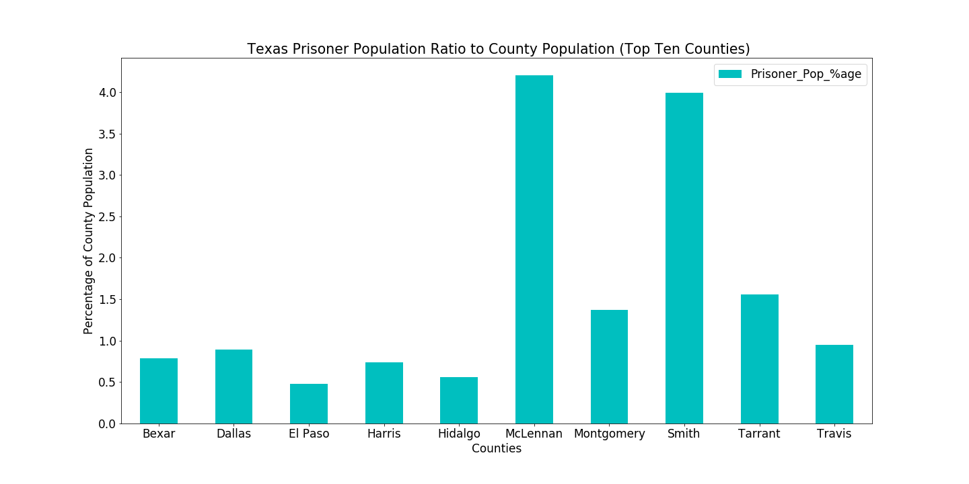
Texas Prison Inmates Population Vs County Population By Percentage

Slide 25
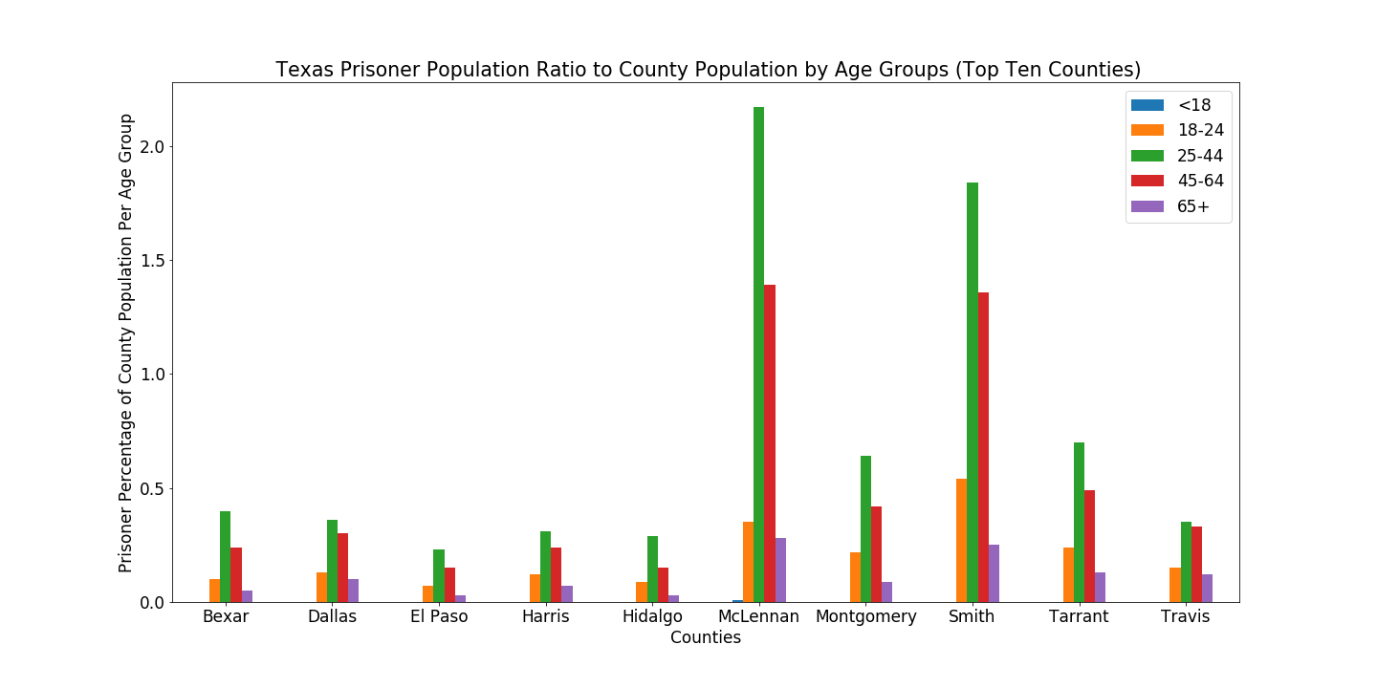
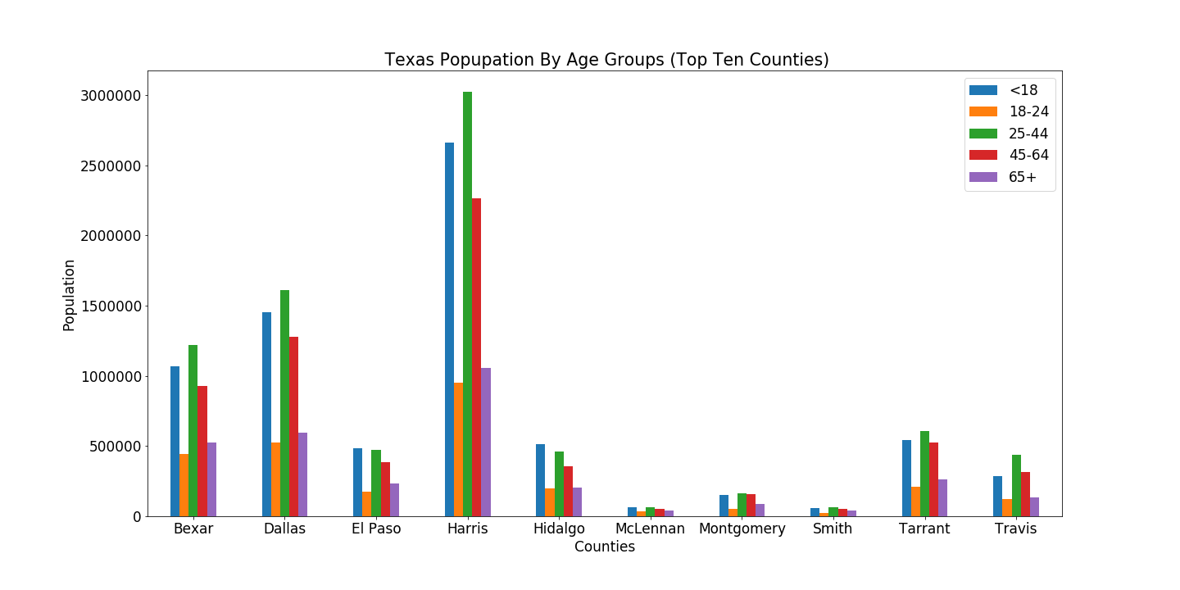
Texas Inmates Analyzed For Comparison With County Population
Percentage of Inmate Population to County Population By Age Brackets
Counties Population By Age Brackets

Slide 26
Question 3 – Conclusions
Much can be gleaned by combining various plots to get an image of the inmates in the Texas prison system. The data shows that Harris county as most populated Texas county has the most inmates across all age groups, even when only male inmates are examined. Some 95% of inmates are male.
Sexual assault become more prevalent from ages above 40 years. Even when only male inmates are considered, from age 45 years, sexual assault is the most obvious offense. Being male, a reasonable inference is that these persons likely find themselves more in broken relationships, consume plenty of pornographic materials and take their frustrations out on women. May be best to explore policy solutions that potentially address these social ills, while enhancing social programs that emphasize proper treatment of other people, especially the opposite sex.
From all 10 counties in this study, of those incarcerated in the Texas prison system, our most productive age groups, i.e., 20 to 60 years are incarcerated. We can think of the impact on families – raising children, instilling proper values in them, and enhancing chance they do not end up in the prison system. Policy makers want to structure programs that enhance inclusion in various ways and engage these ones in productive ways.
With McLennan and Smith having over 3.5% of their county population between ages 25- and 64-year-olds incarcerated in the Texas prison system, largely for sexual assault and drugs, county policy makers would look at the early education system to ensure it improves ethics and values.
By hierarchy, drugs-related crimes have about 15,000 young men between ages 20 and 60 years in prison. There are considerations about decriminalizing these issues, but better focus may be on determining individual extent in the crime and if some of these young men could be re-admitted into society as productive members and new policy measures adopted to rehabilitate such people.

Slide 27
Question 4 – Troy Youngblood
Are there any county outliers?
Use heat maps to present offenses per county; filter on offense
Baseline county population against offenses
Establish population bins to present the data on a relative county population basis

Slide 28
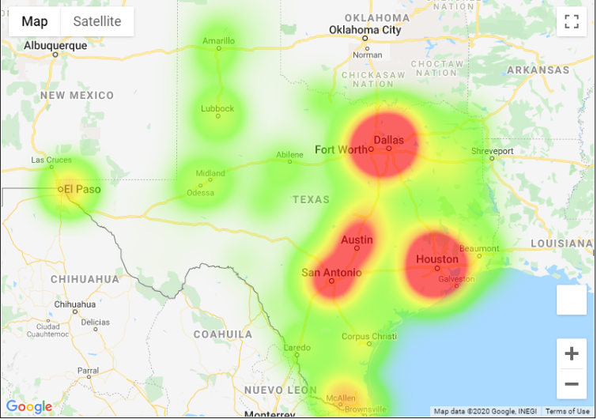
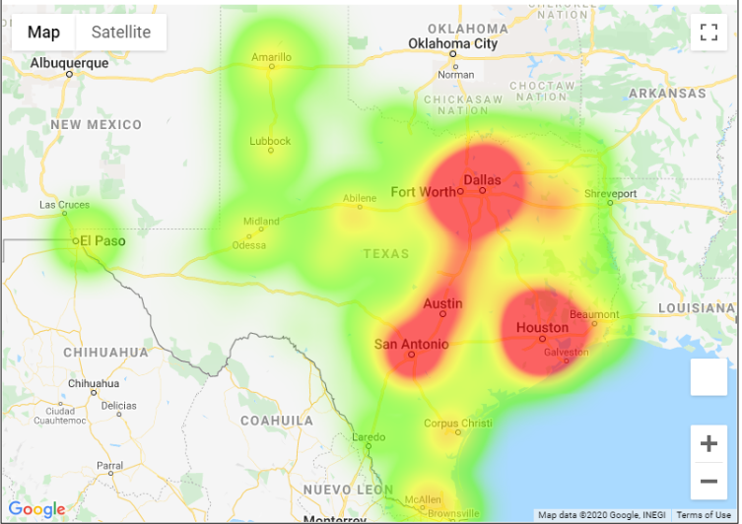
Comparison of Baseline Population Heatmap by County vs Offense location
Baseline population heat map by county
Location of offense by county - total counts
Comparison of the two heatmaps infers there is a higher number of offenses occurring in major population centers or along major paths of travel (interstates or state highways) between those locations. Offense heatmap weighting was adjusted to best match the population in the Dallas / Fort Worth area for comparison purposes.

Slide 29
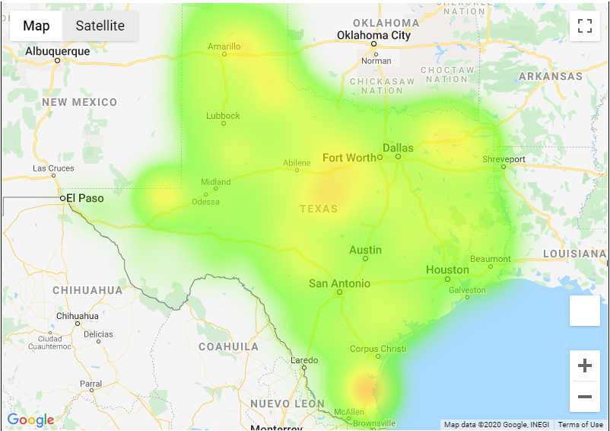
Comparison of Baseline Population Heatmap by County vs Offense location per 1,000 population
Baseline population heat map by county
Location of offense by county – per 1,000 pop
Comparison of the two heatmaps infers there is a higher concentration of offenses occurring per 1000 population in the counties adjacent to major population centers or along major paths of travel (interstates or state highways). Offense heatmap weighting was adjusted to best match the population along the Rio Grande river and Big Bend area for comparison purposes.

Slide 30
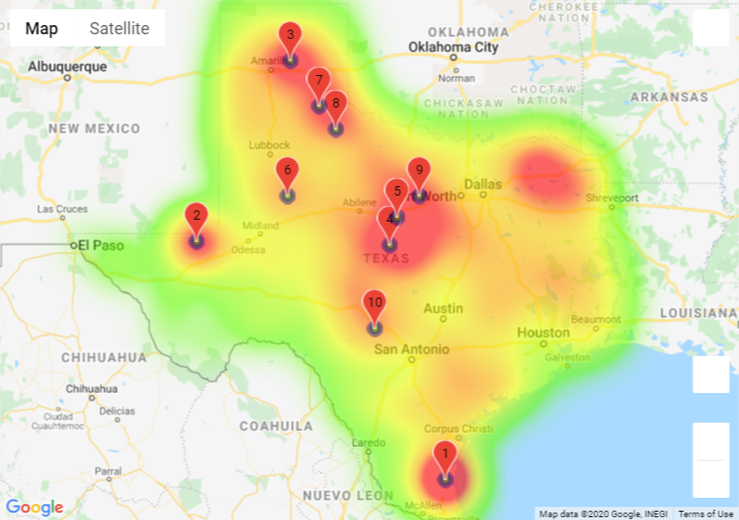
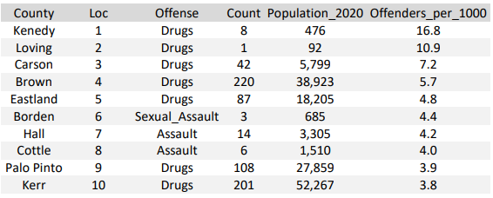
Counties with the highest Offender rates per 1,000 population – independent of total county population
Heat map with county locations
County Statistics
An interesting trend is identified in the above heat map. The majority (6 out of 10) of the counties in the table fall along or near either US 287 going from Fort Worth to Amarillo or US 281 going from San Antonio to Wichita Falls. US 281 and US 287 meet in Wichita Falls. Four of the counties are listed for Drug related charges and 2 are listed for Assault. Kerr county is just northwest of San Antonio and if included in the count it would make 7 out if 10 counties from the table in the general location discussion.

Slide 31
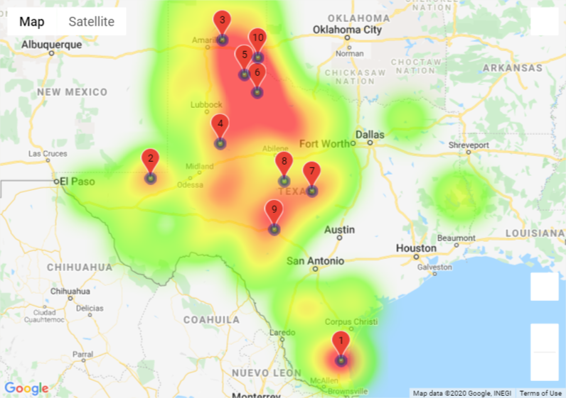
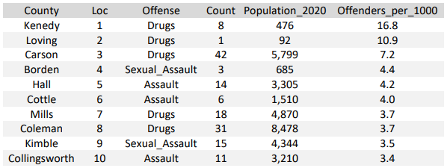
Counties with population less than 10,000 - sorted by Offenders per 1,000 population
Heat map with county locations
County Statistics
Data indicates most of the counties with population less than 10,000 are in west Texas. The data was sorted to present the highest rate of Offenders per 1,000 population. A secondary sort was conducted to remove counties that were listed more than once in the ranking to obtain a view of multiple counties and their rates. Drugs and a form of assault are the primary offense categories in the smallest counties.

Slide 32
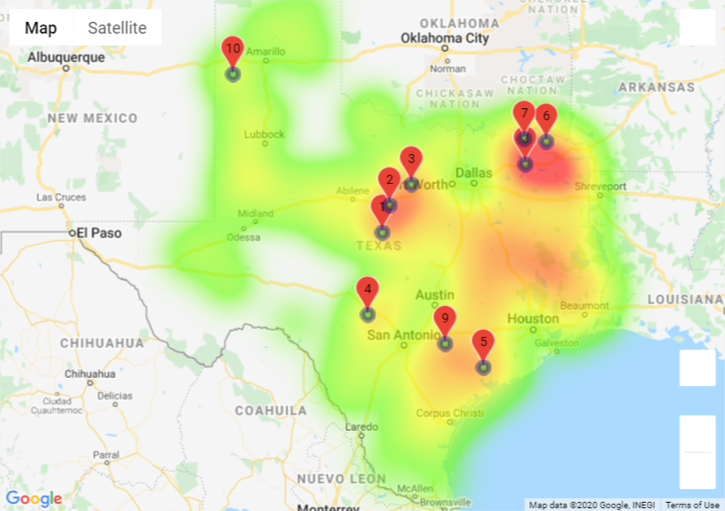
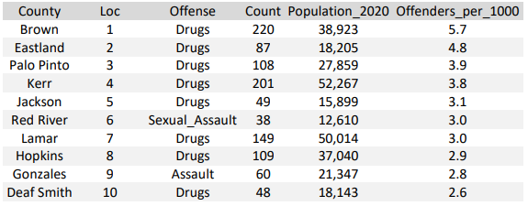
Counties with population between 10,000 and 100,000 - sorted by Offenders per 1,000 population
Heat map with county locations
County Statistics
Data indicates most of the counties with population in the sort range are in central and east Texas. The data was sorted to present the highest rate of Offenders per 1,000 population. A secondary sort was conducted to remove counties that were listed more than once in the ranking to obtain a view of multiple counties and their rates. Drugs are the highest percentage of offenses, followed by a form of assault.

Slide 33
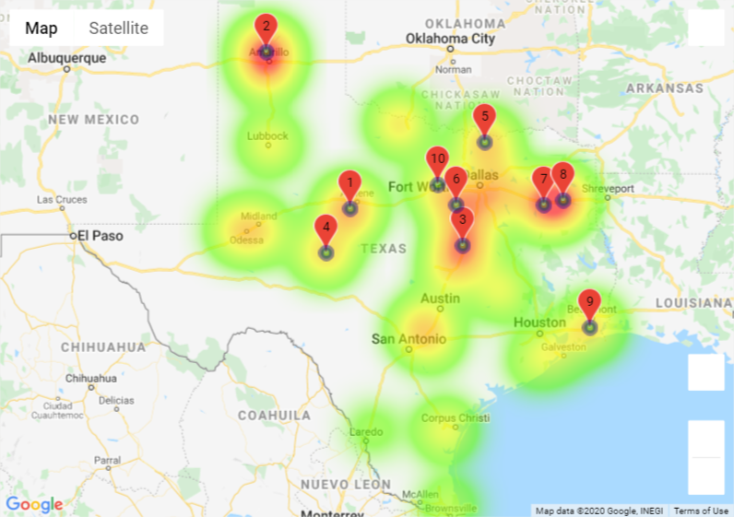
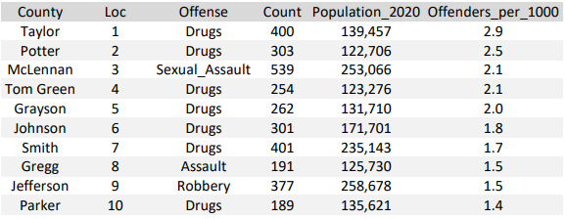
Counties with population between 100,000 and 500,000 - sorted by Offenders per 1,000 population
Heat map with county locations
County Statistics
Data indicates most of the counties with population in the sort range are on or north of I10. The data was sorted to present the highest rate of Offenders per 1,000 population. A secondary sort was conducted to remove counties that were listed more than once in the ranking to obtain a view of multiple counties and their rates. Drugs are the highest percentage of offenses, followed by a form of assault.

Slide 34
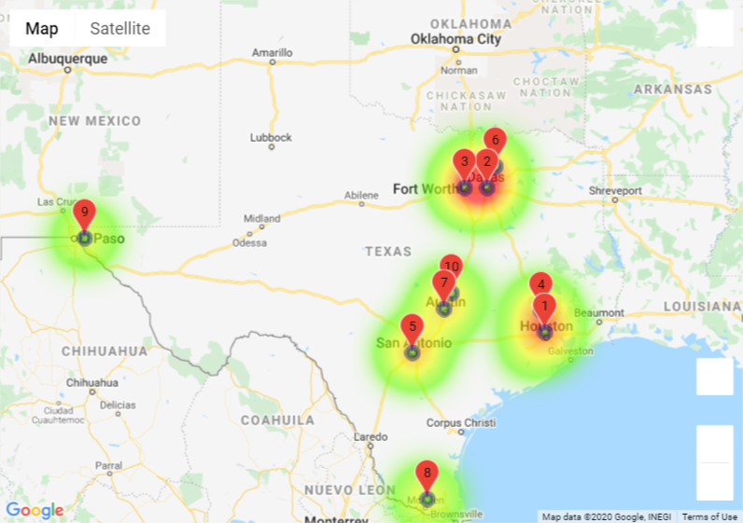
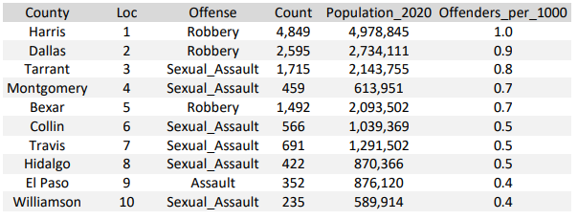
Counties with population greater than 500,000 - sorted by Offenders per 1,000 population
Heat map with county locations
County Statistics
Data indicates most of the counties with population in the sort range are the major population centers along major travel arteries. The data was sorted to present the highest rate of Offenders per 1,000 population. A secondary sort was conducted to remove counties that were listed more than once in the ranking to obtain a view of multiple counties and their rates. Crimes against a person are the primary offense categories.

Slide 35
Q4 - Conclusions
The majority of the counties adjacent to metroplex locations and further out had drug related crimes as their primary offense. The counties with the metroplex locations have crimes against a person as their primary offense.
Data that would be an example of needing a deeper dive:
The heat map that only presented Offense ratios per 1,000 and did not filter for population bin. Is this a major artery for drug movement.?
The heatmap showing the clusters around Tarrant county and in northeast Texas. What else is driving these numbers?

Slide 36
Overall Takeaway
The high-level view only gives a glimpse of the individuals in the prison system and is potentially skewed toward the larger counties.
A deeper dive is needed to identify additional correlations such as single-family homes and completion of primary and secondary education.
Finally - don’t do the crime and you will not do the time

